Slide 1
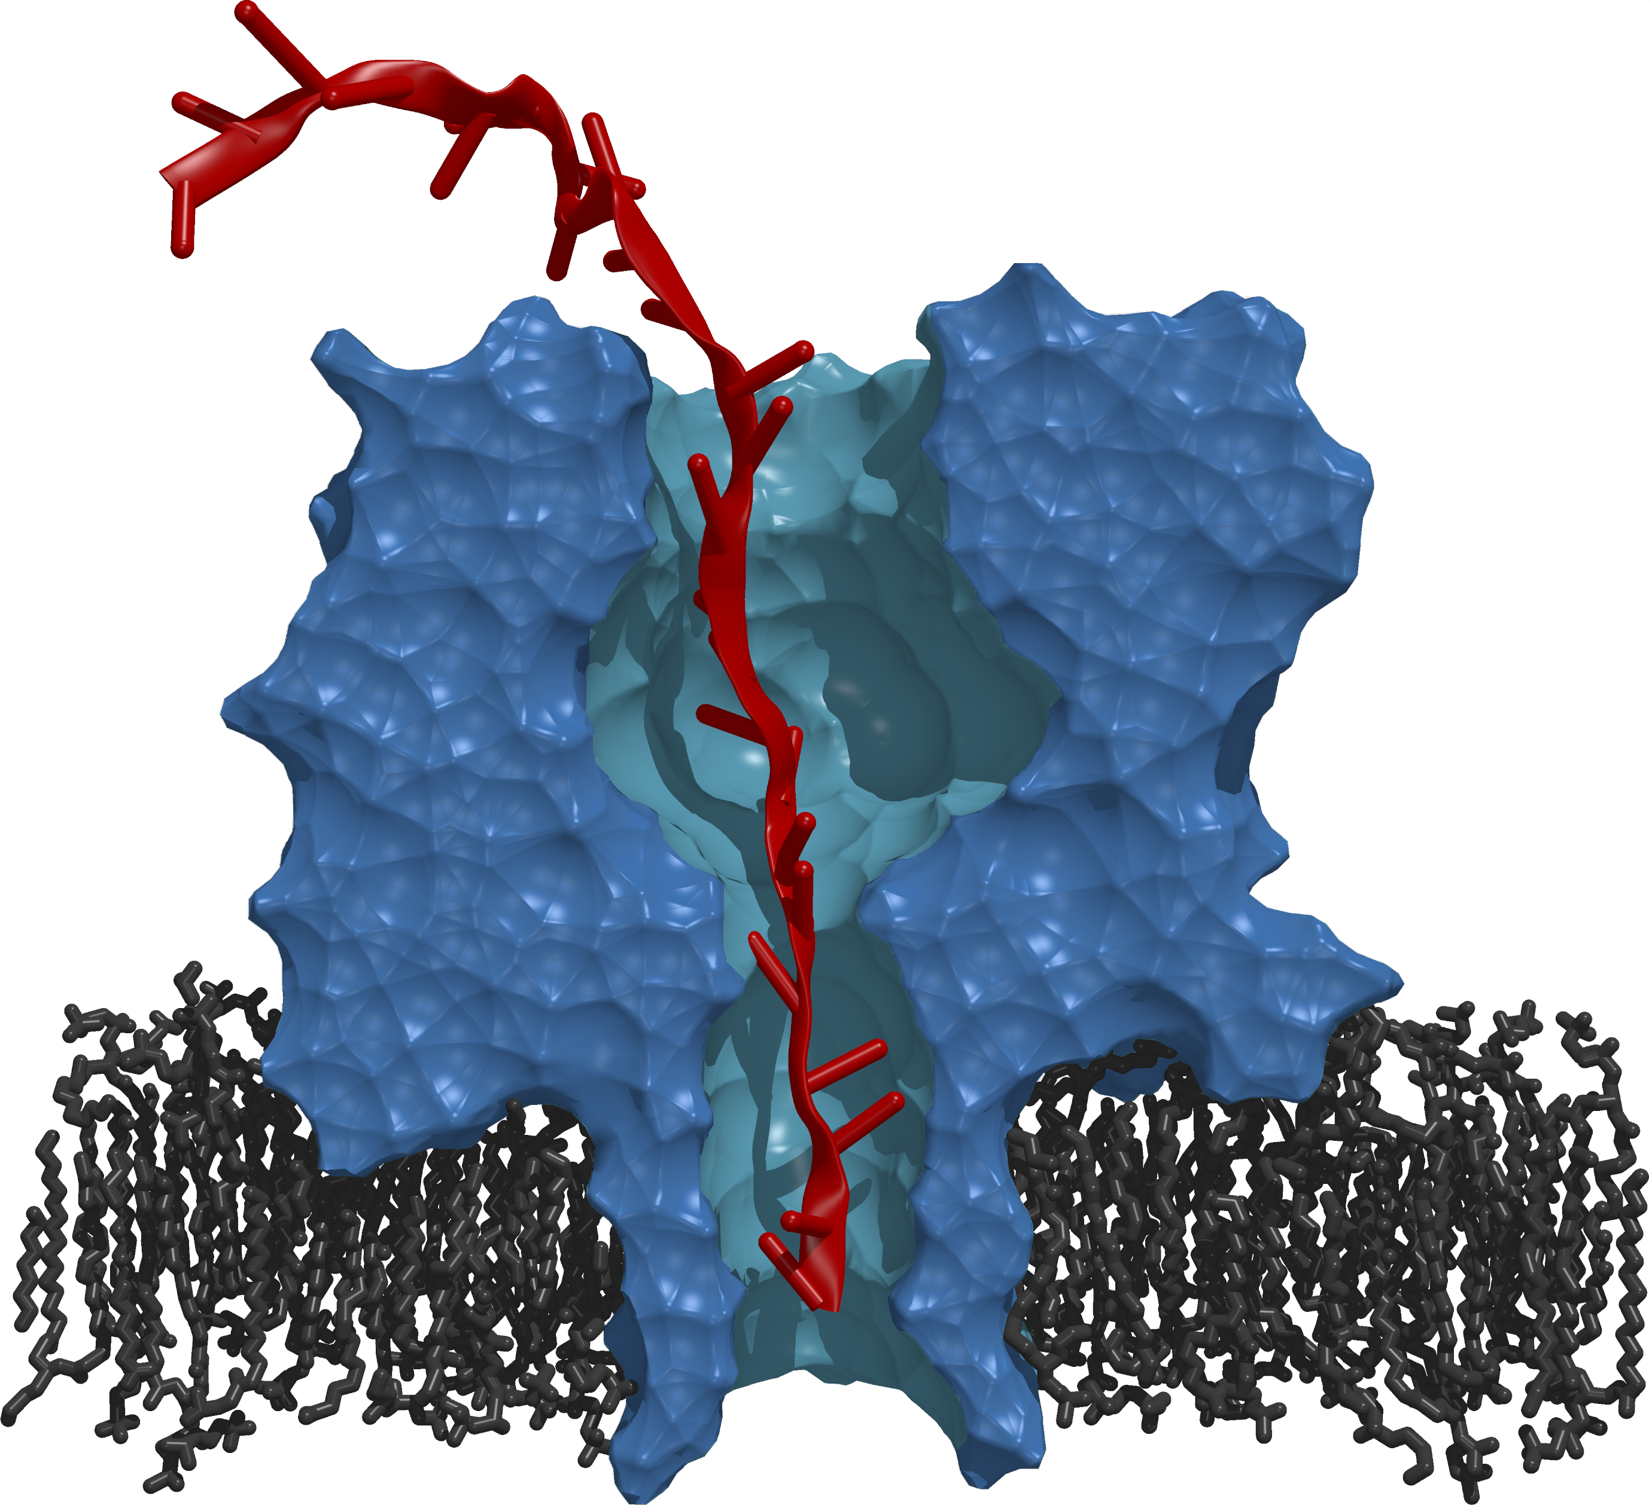
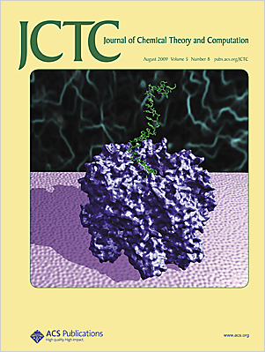
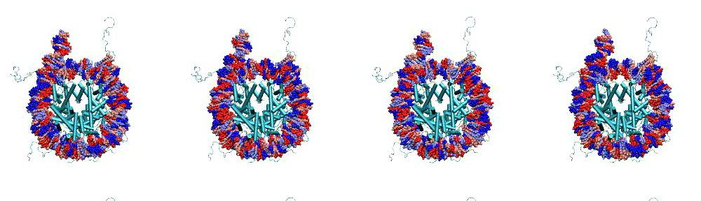
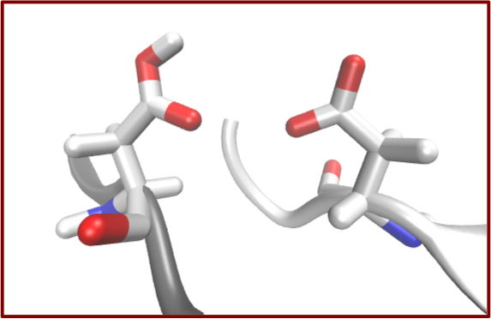
Towards Exascale Through Many Simulations: Abstractions and Tools
Matteo Turilli, Shantenu Jha
http://radical.rutgers.edu

Slide 2
Outline
Exascale program and why many-simulations matter.
Many-simulations scenarios and examples: Ensemble and Replica-exchange.
Engineering challenges to support many-simulations scenarios.
RADICAL models and tools for many-simulation applications.
The present: P*, BigJob and SAGA-python and how they are used to support ensembles and replica-exchange applications.
The future: W*, F* and I* and towards and middleware for exascale.
Notes:
This is different from why distributed exascale computing
PF = PetaFlops
Free-energy = measure of the degree of dynamism of a physical system
Enhance sampling = we cannot sample every state, we use algorithms to reduce the number of sampled state, still effective because of ergodic hypothesis.
Simulation:
Homogeneous/heterogeneous = the same physical system simulated with different parameters / different physical systems
Coordination = Temporal and special ordering (leads to different models of communication?)
Dependences = Temporal among simulations.
Varying across these axes you can generate almost any workflow.
Bag of tasks is the center.

Slide 3

Exascale Computing: View from that side
US Exascale program alive and active:
Exascale programs across agencies DoE/NNSA, DoE, NSF.
Less tolerance for HPC as an activity of the elite and exclusive club:
Even historically HPC oriented agencies (DoE) are looking to support the long-tail of science via more inclusive models of computing.
Increasing amount of effort spent on modeling and simulation of applications and system.
Notes:
, i.e., no PRACE-style snobbery

Slide 4
Many Simulations Pathway to Exascale?
Problems in computational science naturally amenable to “many simulations” model of computing:
Many free energy calculations, enhanced sampling problems.
Many multi-physics simulations are also multi components.
Starting from uncoupled heterogeneous tasks, varying levels of coordination and dependency can be gradually added and “tuned”.
A Single “Application” is broken into many smaller simulations.
Nature of the simulations:
Homogeneous/Heterogeneous.
Coupling between simulations:
Coordination.
Dependences.
D
C
H
Notes:
PF = PetaFlops
Free-energy = measure of the degree of dynamism of a physical system.
Enhance sampling = we cannot sample every state, we use algorithms to reduce the number of sampled states, still effective because of ergodic hypothesis.
Simulation:
Homogeneous/heterogeneous = the same physical system simulated with different parameters / different physical systems
Coordination = Temporal and special ordering (leads to different models of communication?)
Dependences = Temporal among simulations.
Varying across these axes you can generate almost any workflow.
Bag of tasks is the center.

Slide 5
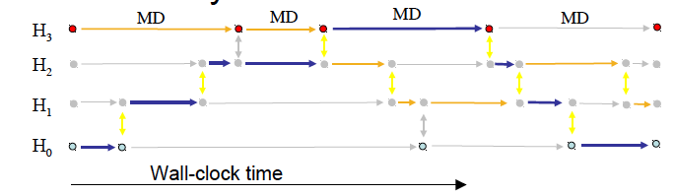
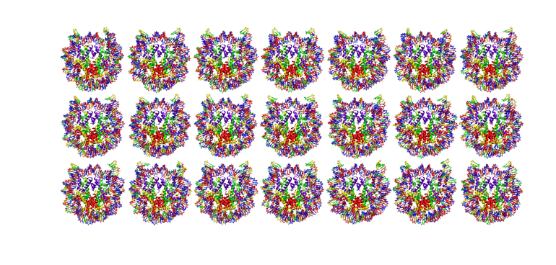
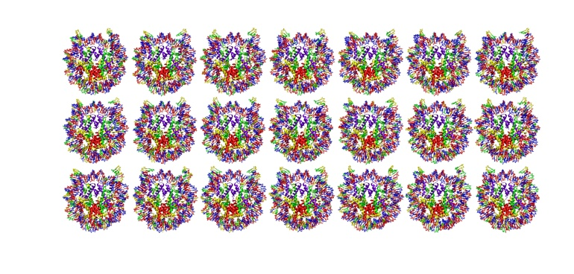
Asynchronous Replica-Exchange: Advanced Algorithms for enhanced sampling.
“A Framework for Flexible and Scalable Replica-Exchange on Production Distributed CI”, Proceedings of Conference on Exsede, 2013.
Scalable Online Comparative Genomics of Mononucleosomes.
“Scalable Online Comparative Genomics of Mononucleosomes: A BigJob” , Proceedings of Conference on Exsede, 2013.
Notes:
Set up the problem of synchronizing many tasks! Get histogram
Many simulation
A simulation is a single MPI job
They are all MPI – 128 – 512 cores for each simulation
Problem 1: determine the binding and position of the mononucleosome – Enemble:
210 combinations, 20 nanoseconds, repeats 10 times to get 20 nanoseconds, 2100 simulations for 1 particular study (candidate). The problem is not reducible and hits the limits of computational availability (e.g. cluster available with queues of 24h)
Group of tasks have temporal dependencies but the tasks themselves are independent (bag of tasks)
Problem 2: Molecular simulation – Replica exchange:
Running multiple replicas at the same time (anything from few to hundreds of thousands, the more the merrier because better approximation to the problem)
Tasks needs to synchronize by means of communication. Different algorithms to do that, pairing pre-defined => regular replica exchange. Replicas are exchanging anyway. Pairing and time of exchange can be fixed (regular) or dynamic (irregular).
For both cases: the more the better for the science.
The class of scientific problems that is amenable to ‘Many Simulations’ approach is called: free energy.

Slide 6
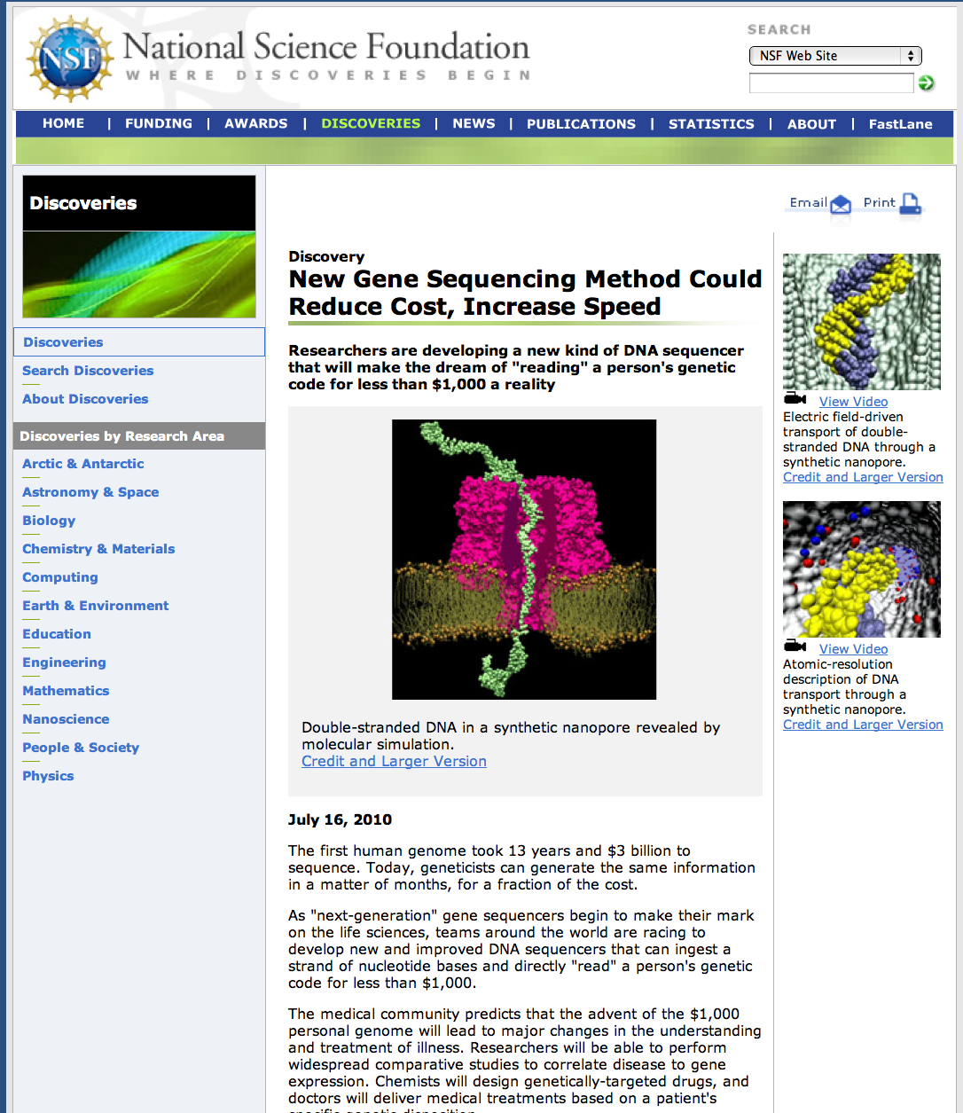
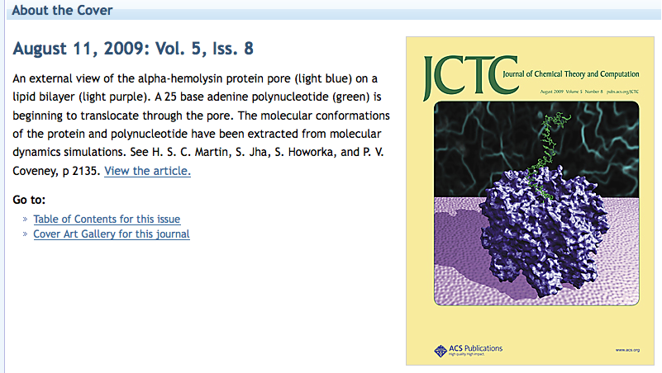
A Pore Man’s View of the TeraGrid/XSEDE
2005-09: Tried running many simulations on many supercomputers. Did not work (well)!
Why? What has changed?
Notes:
We are not speaking about a trivial problem! Formulating a problem in terms of many-simulations (partially) failed already at petascale:
A lot of the time has been spent in formulating the problem in terms of many simulations.
Marshaling/managing/efficient mapping happened at order 10, barely made order 100, broke down at order 1000 (of large simulations)
This problem highlights some of the challenges in running many simulations on many supercomputers
Things are not working. I contend that if we took a more systems approach to building our infrastructure -- viewed as a whole, expose/provide the right abstractions, then it is possible.

Slide 7
Challenges of Many Simulations at Exascale
Many of the “traditional” extreme scale computing:
Adaptive application formulation arising from non-deterministic application behavior requires flexible composition;
Dynamic resource utilization: Growing/shrinking resource pool.
Democratization of HPC/Exascale Computing:
Capture different modes of extreme-scale computing:
Couple exaflops with exabyte: both simulation and analysis.
Integrate multiple O(100) PF computing: exascale as an aggregated capability.
Abstractions:
Decouple workload and resource management.
Provide capabilities in an extensible and interoperable way by ensuring flexibility with performance, and hiding complexity yet exposing simple interfaces.
Need to provide these abstractions as well engineered tools:
Employ CI best practices and software sustainability.

Slide 8
Pilot Abstractions
Working definition: A system that generalizes a placeholder job to provide multi-level scheduling to allow application-level control over the system scheduler via a scheduling overlay.
User Space
User Application
Pilot-Job System
Policies
Pilot-Job
Pilot-Job
Resource Manager
System Space
Resource A
Resource B
Resource C
Resource D

Slide 9
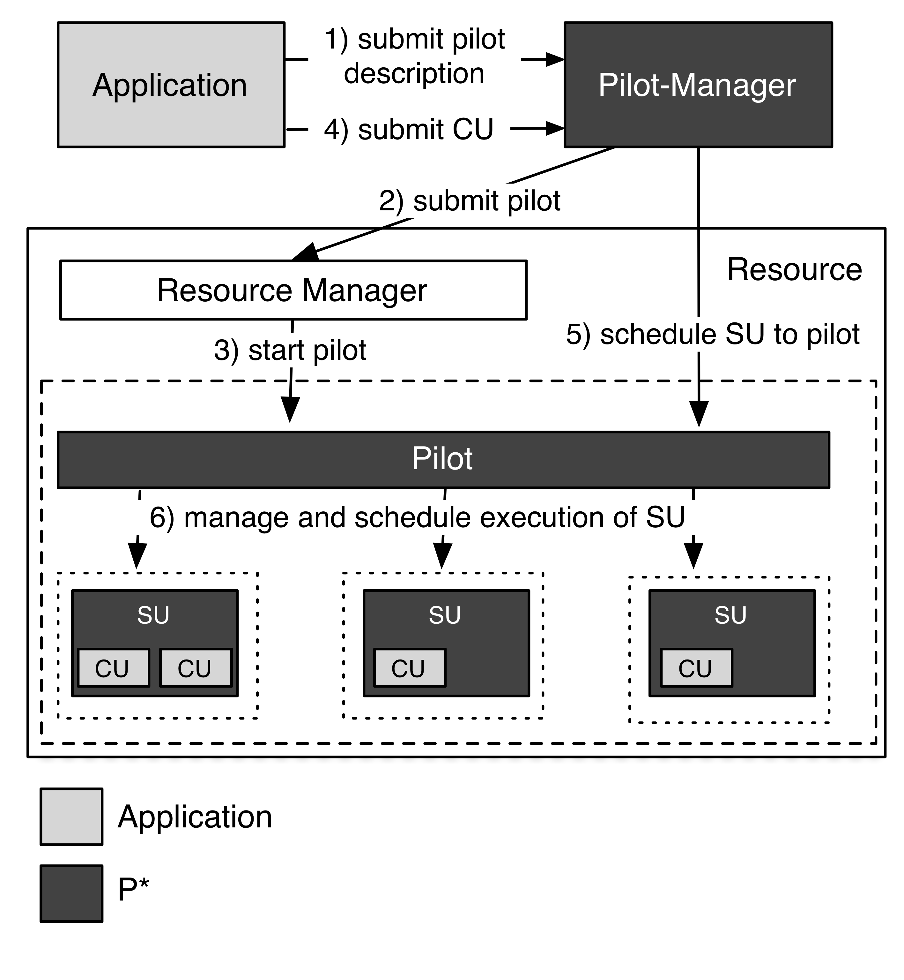
P* Model: Elements, Characteristics and API
Elements:
Pilot-Compute (PC).
Pilot-Data (PD).
Compute Unit (CU).
Data Unit (DU).
Scheduling Unit (SU).
Pilot-Manager (PM).
Characteristics:
Coordination.
Communication.
Scheduling.
Pilot-API.
“P*: A Model of Pilot-Abstractions”, 8th IEEE International Conference on e-Science 2012, 2012

Slide 10
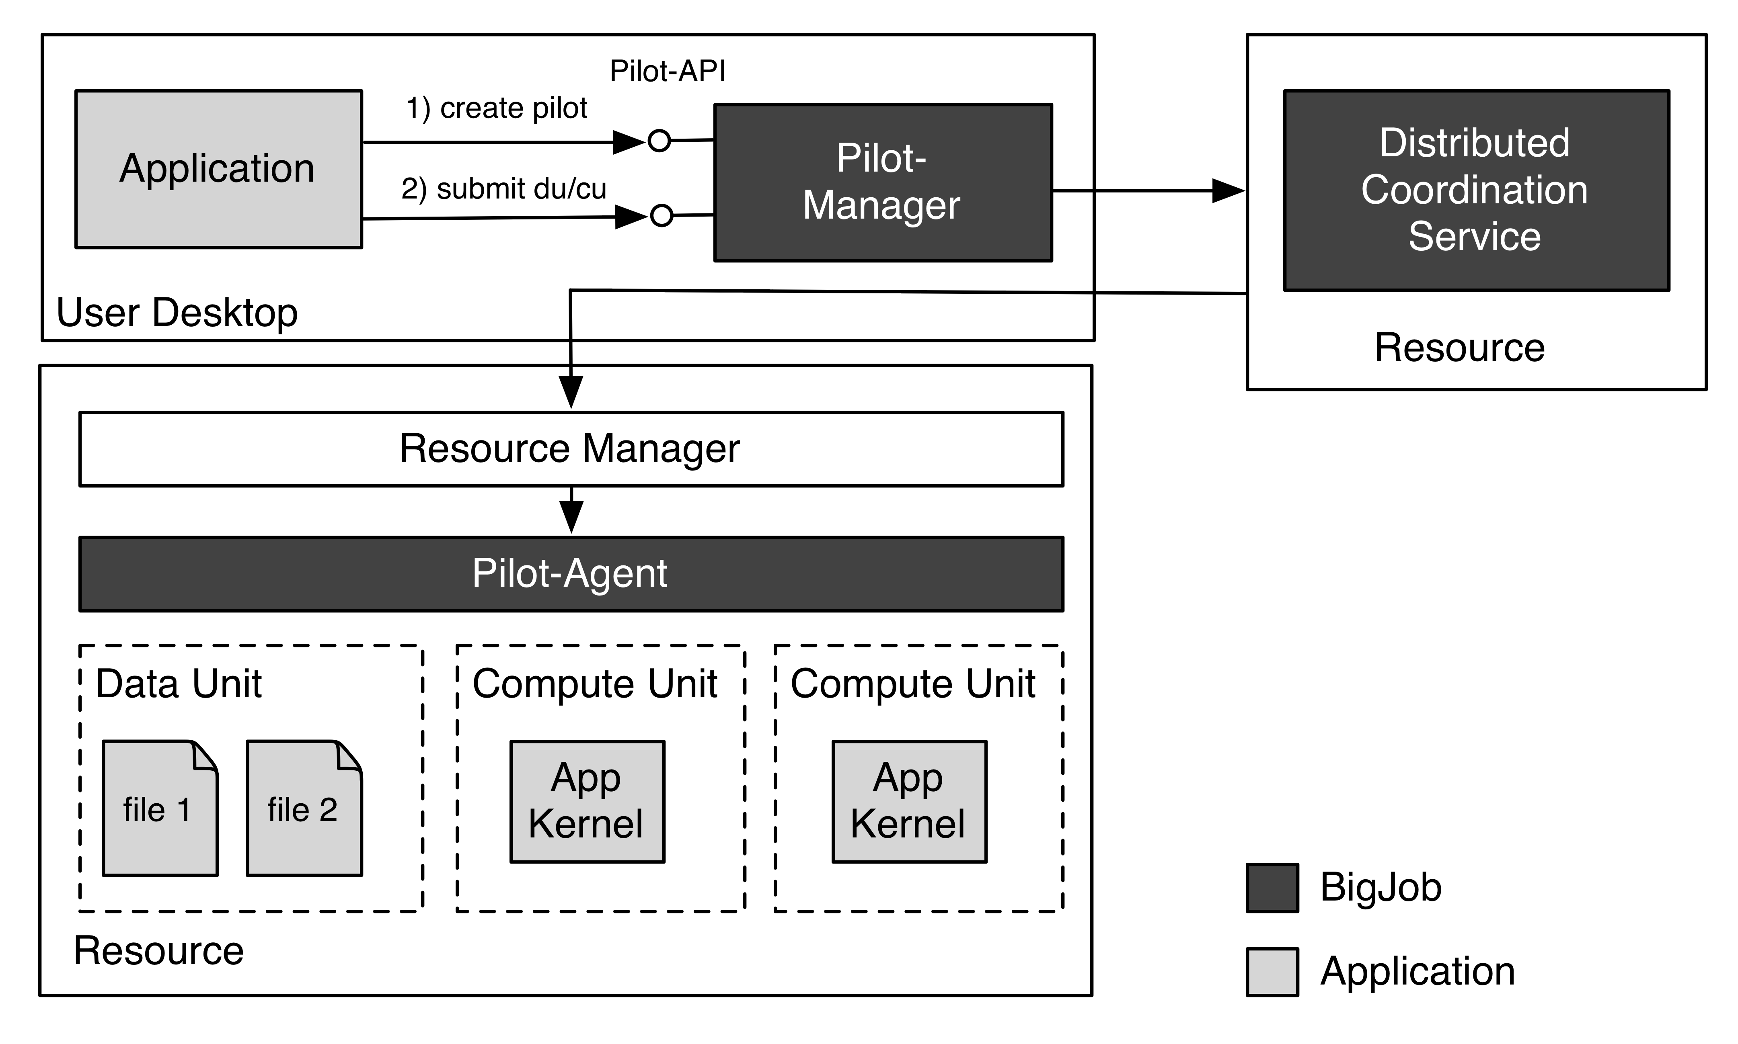
BigJob: Architecture

Slide 11
SAGA: Interoperability Layer for BigJob
SAGA – Simple API for Distributed (“Grid”) Applications:
Application level standardized (Open Grid Forum GFD.90) API.
Application is a broad term: “one person’s application is another person’s tool (building block)”.
SAGA-Python:
Native Python implementation of Open Grid Forum GFD.90.
Allows access to different middleware / services through a unified interface
Provides access via different backend plug-ins (“adaptors”).
SAGA-Python provides both a common API, but also unified semantics across heterogeneous middleware:
Transparent Remote operations (SSH / GSISSH tunneling).
Asynchronous operations.
Callbacks.
Error Handling.

Slide 12
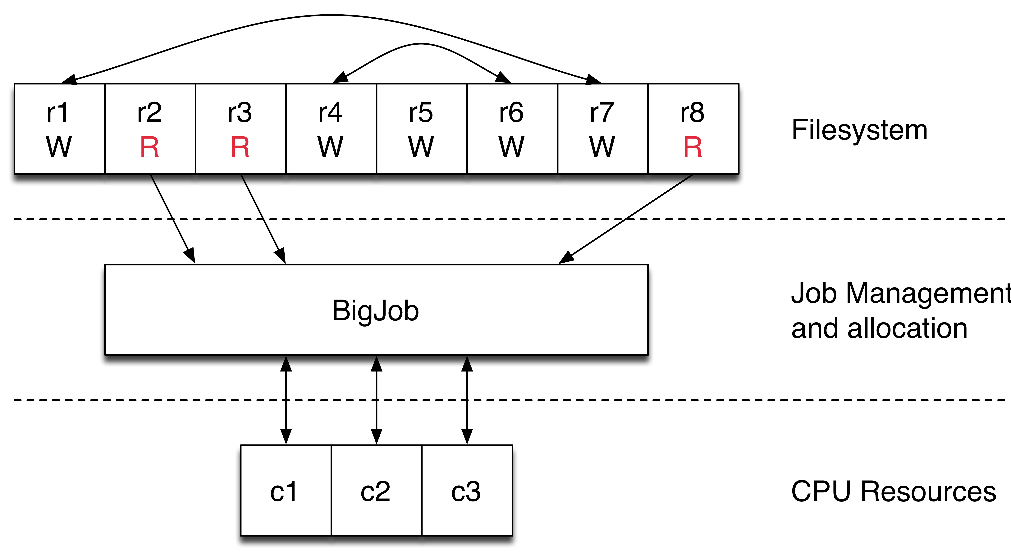
Async Replica-Exchange Package
Python package built to perform file-based asynchronous parallel replica exchange.
Platform independent library.
https://github.com/saga-project/asyncre-bigjob
Notes:
MD?

Slide 13
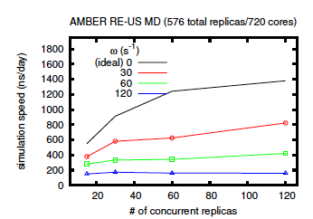
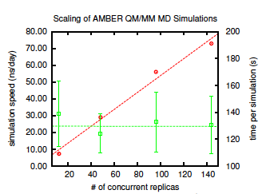
Async Replica-Exchange Package
Ideal performance considered to be zero coupling in this case.
Diminished results due to coordination overheads.
Scientists are free to choose the best tradeoff between simulation speed and number of concurrent replicas.
BigJob-based Repex: Amongst the earliest QM/MM.
Notes:
Rate of communication affect science but it is about the scientist to choose how optimize it. The same is valid of the number of simulation for micro second.
Doing something qualitatively new in quantum mechanical community (second diagram).
Do we have a publication for repex?

Slide 14
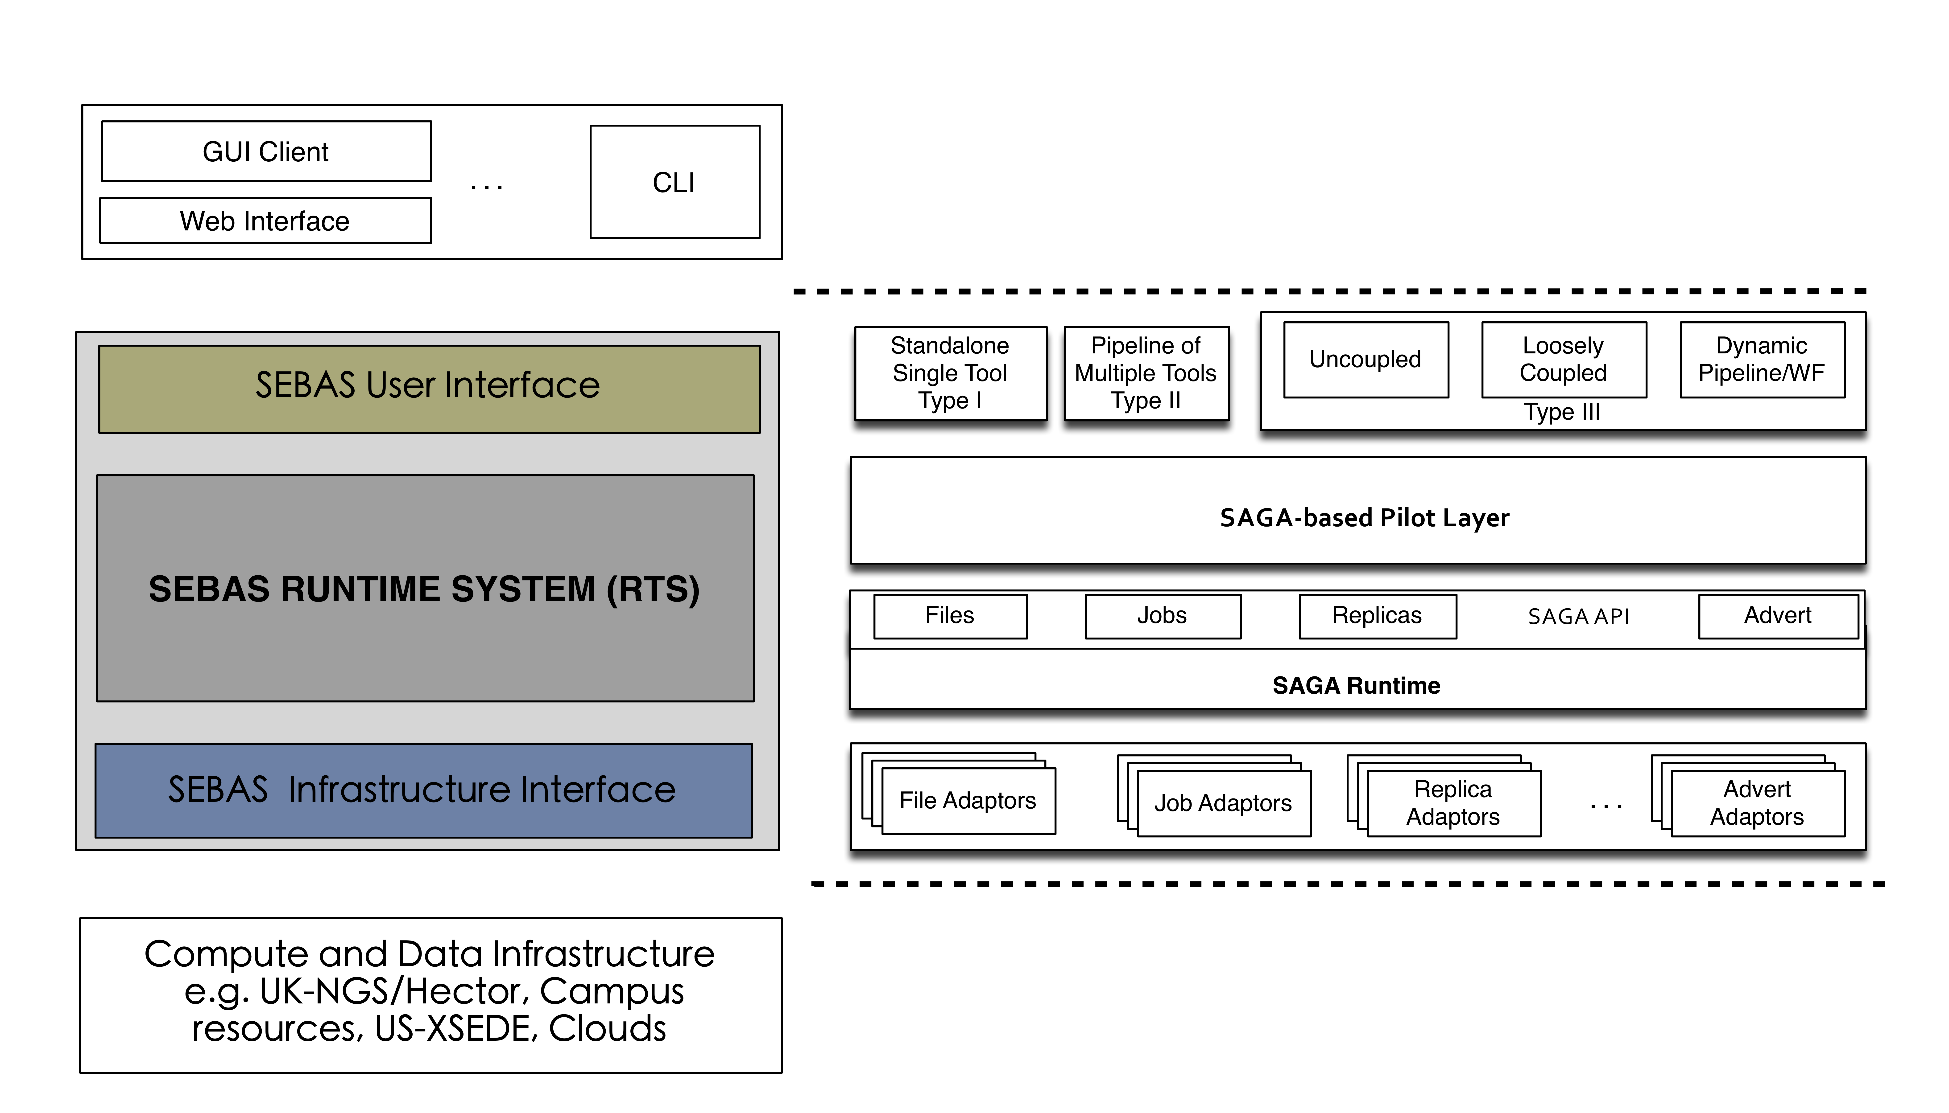
Scalable, Extensible HT Binding Energy Calculation
Platform independent library.
Suggestions for other libraries are welcome!
In consultation with Peter Coveney and Charlie Laughton.
Notes:
Mention EXTASI project: NSF + EPSRC.

Slide 15
Mapping Simulations to Resources
Optimal Characterization – Finding the optimal workload characterization of an application:
Generality versus specificity.
Class of Applications versus Many application classes/types.
Different applications have different metrics.
Optimal Federation – Finding the optimal resource configurations for a given workload:
Irrespective of whether it is best representation of an application.
Resources availability at extreme scale is variable.
Optimal Mapping – Workload to Resource Mapping:
Static versus Dynamic resource mapping.
Notes:
Our research agenda
We start talking about how the simulations will be map to resources.
Point 1: optimal workload representation and there is no notion of resources.
Point 1.1:
We are not focusing on coming up with an optimal representation of a workload.
We are looking for the common underlying workload characterization.
We focus on generality. We do not focus on a single class of application and tools to support it.
We focus on the long tail of science and, as such, on a broad class of application and general-purpose tools to support them.
Point 1.2:
Applications are not only about what to do but also about the temporal and space boundaries for their execution. These parameters define the metrics for the success of the application run
We need to keep in mind when defining a workload.
Point 2: Find the best set of resources for the given workload. No measure of the goodness of the workload description.
Point 3: Combination of 1 and 2. Worry about both workload and resources and resolve the combined problem of putting both of them together.
Point 3.1:
Kernel = i.e. Matrix Manipulation
Traditionally: HPC map a well-known, stable kernel to a resource pool and repeat. Any differential-equation-based problem (heat diffusion for example)
Workload changes over time, it is dynamic and the kernel may change and, as a consequence, the mapping of the resources to that kernel changes too. E.g. many simulation problem.
In the many simulation time also resources are dynamic and their change in state might trigger a change in mapping.

Slide 16
Towards an Exascale Middleware
Workloads (W*)
Unified description: Workload representations from multiple applications are reduced into a minimal, common description.
Translation of the given workload into compute, data, and network units depending on the type and state of the available resources.
Overlays and Resources (F*, I*)
Automation of the description, instantiation, and management of resource overlays for the given workload based on pilot abstractions.
Resource bundles: low-level resource aggregation.
Resource federation: high-level capabilities aggregation.
Workloads and overlays
Multiple algorithms available to schedule pilots onto resources and units onto pilots.
Decoupling between workloads and overlay utilization: Workflows, minimizing overlay overheads and maximizing overlay utilization.

Slide 17
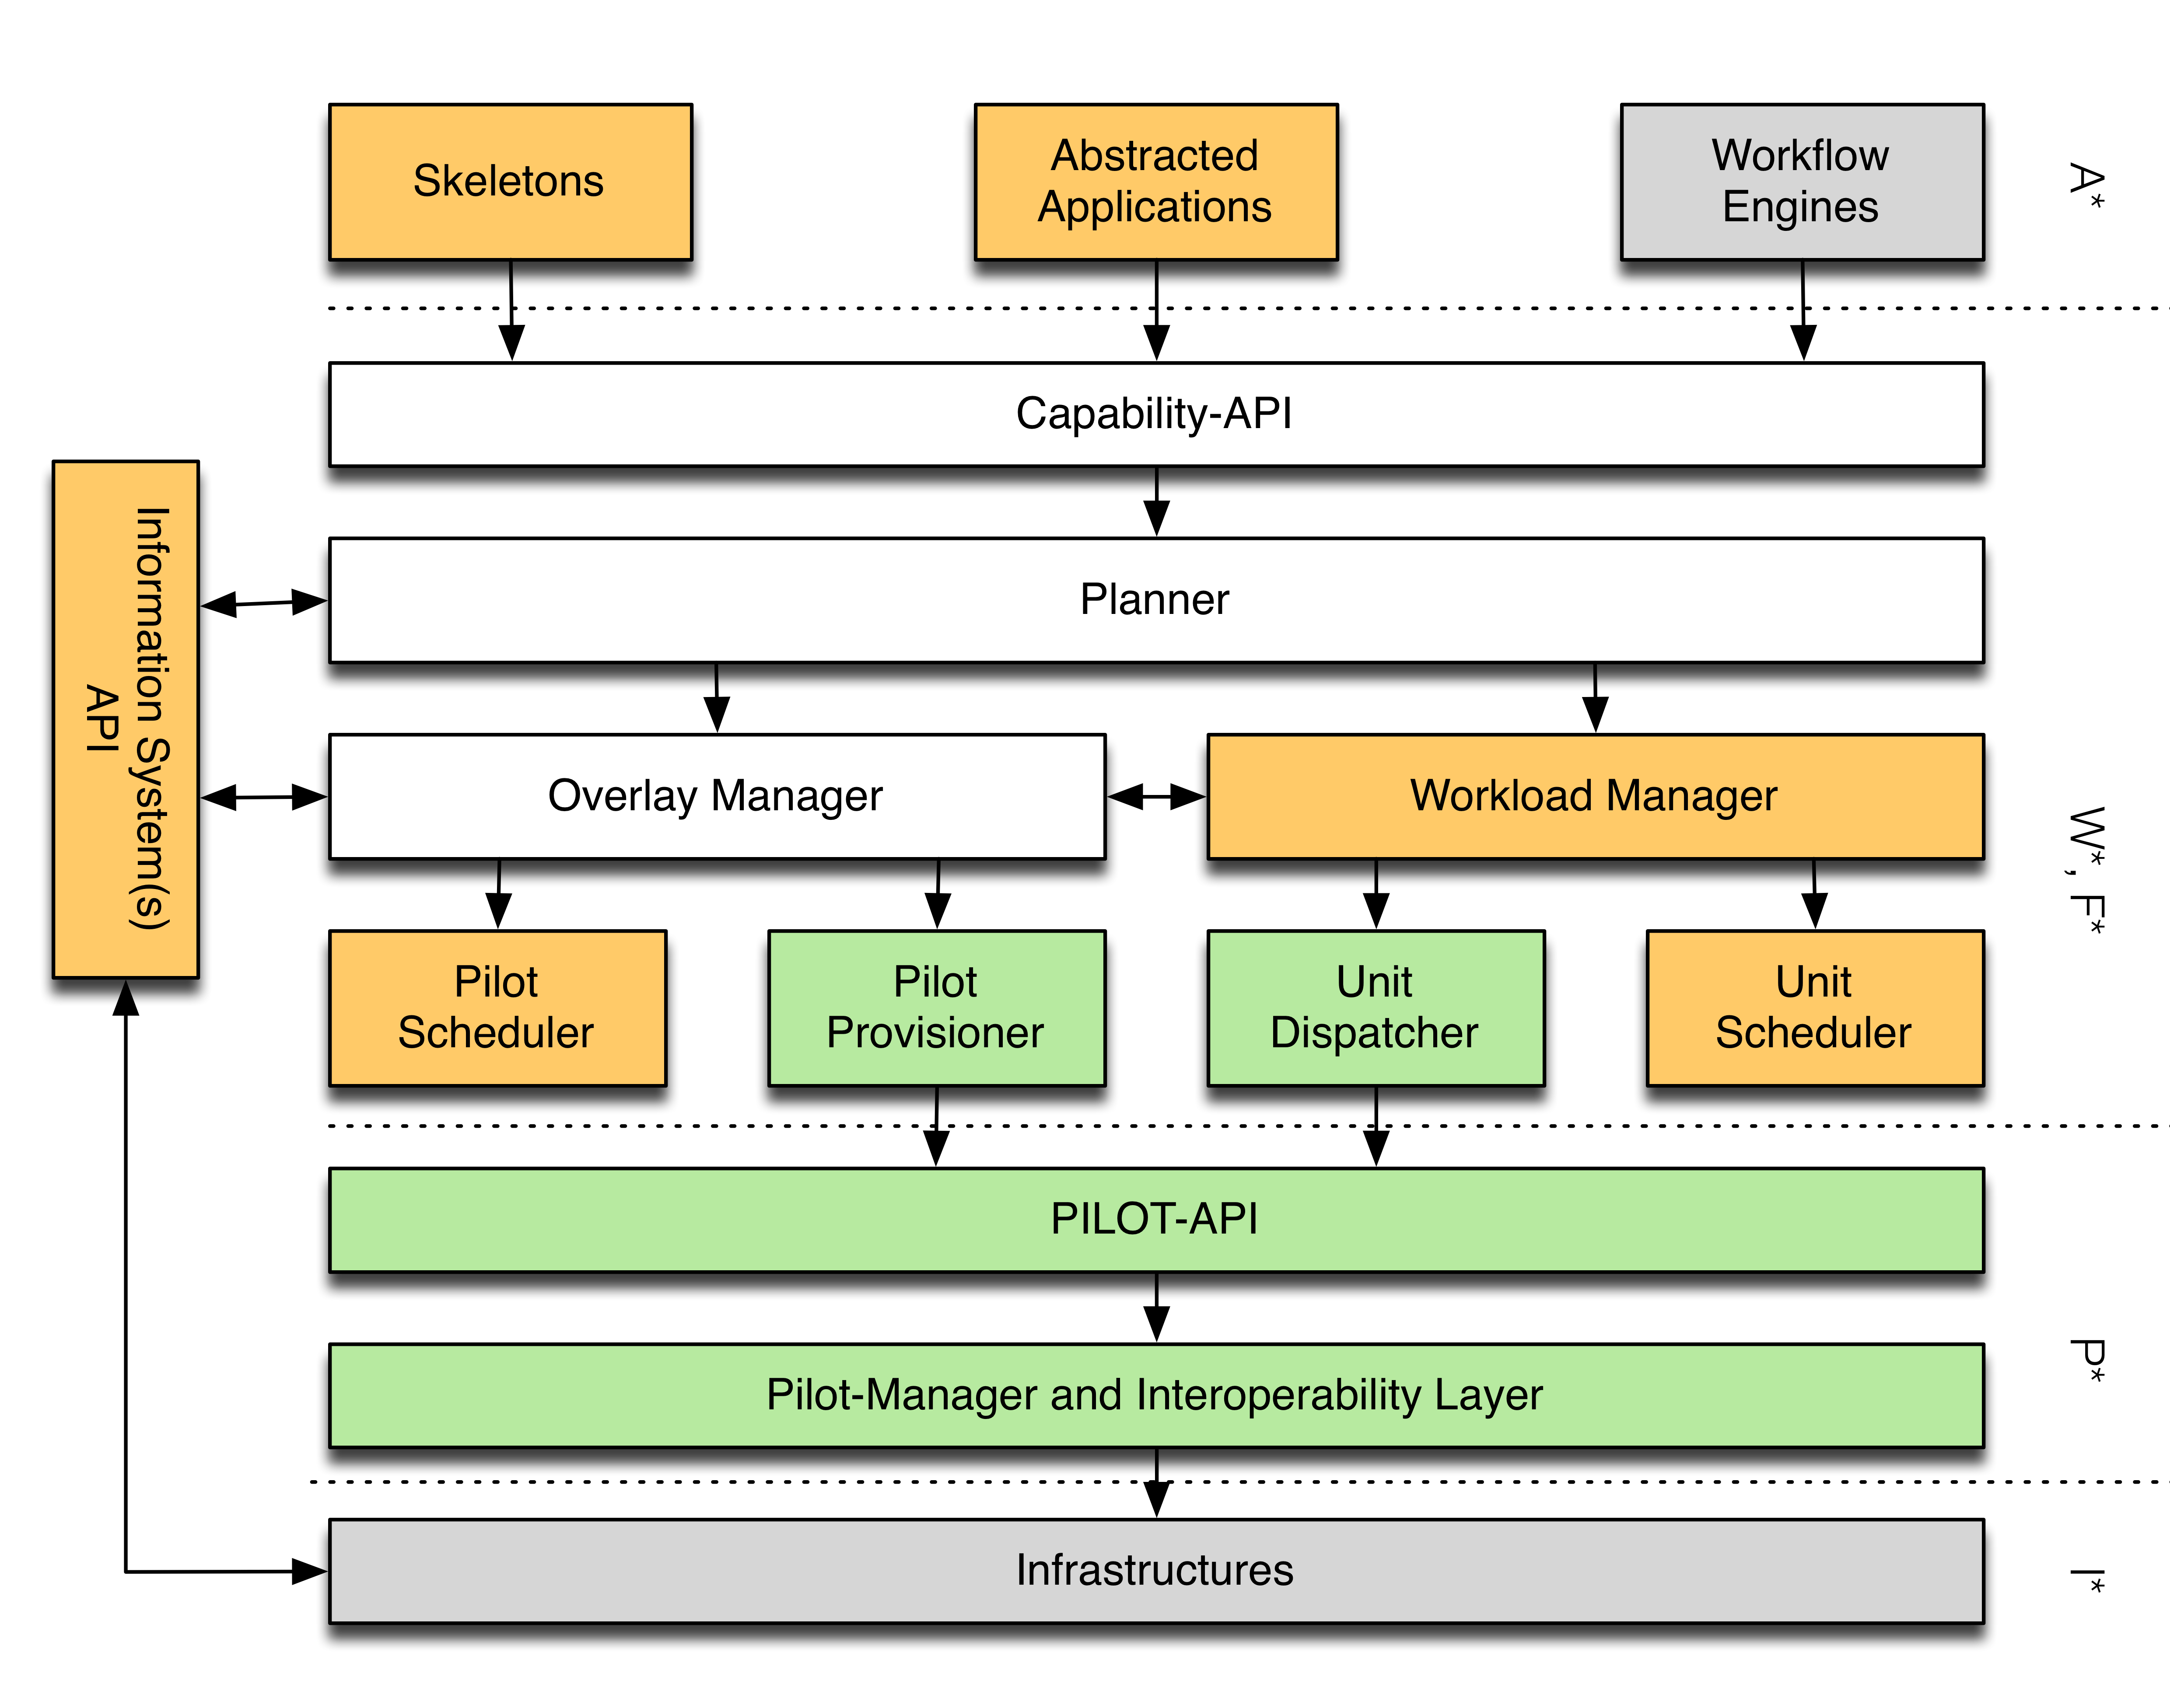
Overlay and Workload Manager (OWM)

Slide 18
Thank you
SAGA-Python:
http://saga-project.github.io/saga-python/
BigJob: An implementation of P*
http://saga-project.github.io/BigJob/
RADICAL:
http://radical.rutgers.edu/
Publications:
http://radical.rutgers/edu/publications
Tutorials:
https://github.com/saga-project/tutorials/wiki/XSEDE13

Slide 19
Towards a Next Generation Middleware
Models

